Slide 1
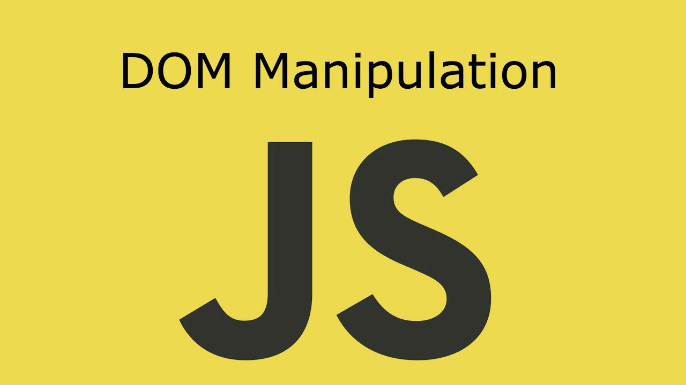
DOM Manipulations
Create / Delete DOM Elements, Handle Browser Events
SoftUni Team
Technical Trainers
Software University
http://softuni.bg

Slide 2
Table of Contents
Event Loop
Event Types
Event Object Properties and Methods
Handling Events

Slide 3
Have a Question?
sli.do #JS-ADVANCED

Slide 4

Event Loop

Slide 5
JS approach to I/O
Single threaded language
HTTP requests
DB
Memory and disk read/write

Slide 6
Don't make the thread wait
Blocking thread requests
Register a callback
Handle multiple concurrent operations on one thread

Slide 7
How it's handled in JS?
Message queue
Event loop

Slide 8
Stack calls
function foo(x) {
return x * x;
}
function bar(y) {
return foo(y + 2);
}
bar(8);
Stack

Slide 9
Stack calls
function foo(x) {
return x * x;
}
function bar(y) {
return foo(y + 2);
}
bar(8);
Stack
bar(8)

Slide 10
Stack calls
function foo(x) {
return x * x;
}
function bar(y) {
return foo(y + 2);
}
bar(8);
Stack
foo(10)
bar(8)

Slide 11
Stack calls
function foo(x) {
return x * x;
}
function bar(y) {
return foo(y + 2);
}
bar(8);
Stack
return
bar(8)

Slide 12
Stack calls
function foo(x) {
return x * x;
}
function bar(y) {
return foo(y + 2);
}
bar(8);
Stack
bar(8)

Slide 13
Stack calls
function foo(x) {
return x * x;
}
function bar(y) {
return foo(y + 2);
}
bar(8);
Stack
return

Slide 14
Stack calls
function foo(x) {
return x * x;
}
function bar(y) {
return foo(y + 2);
}
bar(8);
GC

Slide 15
Stack calls
function foo(x) {
return x * x;
}
function bar(y) {
return foo(y + 2);
}
bar(8);
Stack

Slide 16
function init(el){
el.addEventListener(
"click",
handler
);
}

Slide 17
Stack calls
Stack
Browser APIs
Hidden implementation

Slide 18
Stack calls
Stack
Browser APIs
Hidden implementation
init

Slide 19
Stack calls
Stack
Browser APIs
Hidden implementation
addEventListener
init

Slide 20
Stack calls
Stack
Browser APIs
Hidden implementation
addEventListener
init
Event Callback

Slide 21
Stack calls
Stack
Browser APIs
Hidden implementation
return
init
Event Callback

Slide 22
Stack calls
Stack
Browser APIs
Hidden implementation
return
Event Callback

Slide 23
Stack calls
Stack
Browser APIs
Hidden implementation
GC
Event Callback

Slide 24
Stack calls
Stack
Browser APIs
Hidden implementation
Event Callback

Slide 25
Stack calls
Stack
Browser APIs
Hidden implementation
Message Queue
….
Event Callback

Slide 26
Stack calls
Stack
Event Loop
Browser APIs
Hidden implementation
Message Queue
….
Event Callback

Slide 27
Stack calls
Stack
Event Loop
Browser APIs
Hidden implementation
Message Queue
H
….
Event Callback

Slide 28
Stack calls
Stack
Event Loop
Browser APIs
Hidden implementation
Message Queue
H
H
Event Callback

Slide 29
Stack calls
Stack
Event Loop
Browser APIs
Hidden implementation
Message Queue
H
H
Event Callback

Slide 30
Stack calls
Stack
Event Loop
Browser APIs
Hidden implementation
Message Queue
H
H
handler
Event Callback

Slide 31
Stack calls
Stack
Event Loop
Browser APIs
Hidden implementation
Message Queue
H
handler
Event Callback

Slide 32
Stack calls
Stack
Event Loop
Browser APIs
Hidden implementation
Message Queue
H
return
Event Callback

Slide 33
Stack calls
Stack
Event Loop
Browser APIs
Hidden implementation
GC
Message Queue
H
Event Callback

Slide 34
Stack calls
Stack
Event Loop
Browser APIs
Hidden implementation
Message Queue
H
Event Callback

Slide 35
Stack calls
Stack
Event Loop
Browser APIs
Hidden implementation
Message Queue
H
handler
Event Callback

Slide 36
Stack calls
Stack
Event Loop
Browser APIs
Hidden implementation
Message Queue
handler
Event Callback

Slide 37
Stack calls
Stack
Event Loop
Browser APIs
Hidden implementation
Message Queue
return
Event Callback

Slide 38
Stack calls
Stack
Event Loop
Browser APIs
Hidden implementation
GC
Message Queue
Event Callback

Slide 39
Stack calls
Stack
Event Loop
Browser APIs
Hidden implementation
Message Queue
Event Callback

Slide 40

DOM Events
Handling DOM Events

Slide 41
DOM Events
Window
CAPTURE
BUBBLING
Document
<HTML>
<BODY>
<HEADER>
<DIV>
<DIV>
<A>
<A>
TARGET

Slide 42
Event Types in DOM API
Mouse events
Touch events
DOM / UI events
click
mouseover mouseout mousedown
mouseup
touchstart
touchend
touchmove
touchcancel
load
unload
resize
dragstart / drop
Keyboard events
Focus events
Form events
keydown
Keypress
keyup
input
change
submit
reset
focus (got focus)
blur (lost focus)

Slide 43
Event Object
Calls its associated function
Passes a single argument to the function - a reference to the event object
Contains a number of properties that describe the event that occurred

Slide 44
Event Object Properties and Methods
Properties
target
timeStamp
isTrusted
clientX/Y
Methods
preventDefault
stopPropagation
stopImmediatePropagation

Slide 45

Live Exercises

Slide 46

Event Handling

Slide 47
Event Handler
Event registration is done by providing a callback function
Three ways to register for an event:
With HTML Attributes
Using DOM element properties
Using DOM event handler
function handler(event){
this => object, html reference
event => object, event configuration }

Slide 48

Event Listener
addEventListener();
removeEventListener();
htmlRef.addEventListener( 'click' , handler , false );
htmlRef.removeEventListener( 'click' , handler);

Slide 49
Attaching Click Event
const button = document.getElementsByTagName('button')[0];
button.addEventListener('click', clickMe);
function clickMe(e) {
const target = e.currentTarget;
const targetText = target.textContent;
target.textContent = (+targetText) + 1;
}

Slide 50
Attaching Hover Event
const button = document.getElementsByTagName('div')[0];
button.addEventListener('mouseover', function (e) {
const style = e.currentTarget;
const { backgroundColor } = style;
if(backgroundColor === 'white'){
targetStyles.backgroundColor = '#234465';
targetStyles.color = 'white';
} else {
targetStyles.backgroundColor = 'white';
targetStyles.color = '#234465';
}}
);

Slide 51
Attaching Input Event
const inputField = document.getElementsByTagName('input')[0];
const button = document.getElementsByTagName('button')[0];
inputField.addEventListener('input', function () {
button.setAttribute('disabled', 'false')
});

Slide 52
Remove Events
const password = document.querySelector('input[type="password"]');
const button = document.querySelector('button');
password.addEventListener('focus', focusEvent);
function focusEvent (){
event.target.style.background = '#234465';
}
password.addEventListener('blur', (event) => {
event.target.style.background = '';
});
button.addEventListener('click', () => {
password.removeEventListener('focus', focusEvent);
});

Slide 53
Multiple Events
The addEventListener() method also allows you to add many events to the same element, without overwriting existing events:
Note that you don't use the "on" prefix for the event use "click" instead of "onclick"
element.addEventListener("click", function);
element.addEventListener("click", myFunction);
element.addEventListener("mouseover", mySecondFunction);
element.addEventListener("mouseout", myThirdFunction);

Slide 54

SetInterval() / ClearInterval()
In JS we can start / stop timers (intervals)
Remove (cancel) existing timer
let intervalID = setInterval(
function() {
console.log("1 sec. passed");
},
1000
); // Delay = 1000 ms = 1 second
clearInterval(intervalID); // Stop the timer

Slide 55
Live Exercises

Slide 56

Event Delegation

Slide 57
DOM Event Delegation
Allows you to avoid adding event listeners to specific nodes
Event listener is assigned to a single ancestor
<ul id="parent-list">
<li id="post-1">Item 1</li>
<li id="post-2">Item 2</li>
</ul>
document.getElementById("parent-list").addEventListener("click", function(e) {
if(e.target && e.target.nodeName == "LI") {
console.log("List item ", e.target.id.replace("post-", ""), " was clicked!");
}
});

Slide 58
Pros and Cons
Benefits
Simplifies initialization
Saves memory
Less code
Limitations
Event must be bubbling
May add CPU load

Slide 59
Live Exercises

Slide 60
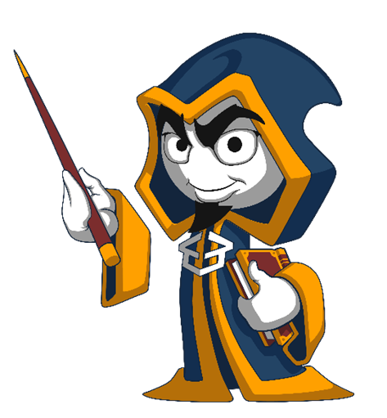
Summary
Arrow functions ≈ short function syntax
Event Loop
Event Types
Event Object Properties and Methods
preventDefault
stopPropagation
Handling Events
Attach
Remove

Slide 61
https://softuni.bg/courses/js-advanced

Slide 62












SoftUni Diamond Partners

Slide 63




SoftUni Organizational Partners

Slide 64




Trainings @ Software University (SoftUni)
Software University – High-Quality Education and Employment Opportunities
softuni.bg
Software University Foundation
http://softuni.foundation/
Software University @ Facebook
facebook.com/SoftwareUniversity
Software University Forums
forum.softuni.bg

Slide 65

License
This course (slides, examples, demos, videos, homework, etc.) is licensed under the "Creative Commons Attribution-NonCommercial-ShareAlike 4.0 International" license

